Slide 1

THINKING LIKE A DESIGNER
CHAPTER 01
‹#›

Slide 2
Topics
Welcome to Game Design
You Are a Game Designer!
Bartok: A Game Design Exercise
The Definition of Game
‹#›

Slide 3
Welcome to Game Design
Welcome to Introduction to Game Design, Prototyping, and Development
Game Design: The iterative process of crafting interactive experiences for players
Prototyping: The creation of various paper and digital tests for your game design
Development: The programming and implementation of a digital game that has been refined through prototyping
This book and these lectures cover all three topics as well as many other supporting topics that will make you a better game designer
‹#›

Slide 4
Welcome to Game Design
Do game designers need to know how to program?
Some designers, like Chris Hecker (Spy Party) feel that designers must know how to program
Other very successful designers like Nicholas Fortugno (Diner Dash) are not programmers at all
So, what do you think?
‹#›

Slide 5
Welcome to Game Design
In my opinion, programming for game designers is like sketching for cinematographers
Game prototypes are the clearest way for a designer to convey her game ideas to other members of the team
If you learn to program and prototype, it will make your job as a game designer much simpler
The ability to program will also allow you to create prototypes and test ideas without needing help from others
This is why it was so important for IGDPD to cover design, prototyping, and development
Though they are not strictly necessary, both prototyping and development will make you a more effective and more capable game designer
‹#›

Slide 6
You Are a Game Designer!
Why am I asking you to do this?
According to Robert Cialdini's book, Influence: The Art of Persuasion, people are more likely to follow through if they state out loud that they will do so
Say it one more time:
I am a game designer.
‹#›

Slide 7
You Are a Game Designer!
But, this class is actually teaching you to design more than just games
The techniques you learn in this class will teach you to design any kind of interactive experience:
Games
Parties
Events
etc.
You're more than just a game designer
I am an experience designer.
‹#›

Slide 8
You Are a Game Designer!
You've said it three times now
To reinforce it even more, you can post it to Facebook or another social network
The more people that you tell you are a game designer, the more likely you are to follow through!
Now that you're a game designer, it's time for your first game design exercise
‹#›

Slide 9
Bartok: A Game Design Exercise
Bartok is a classic card game that is similar to the commercial game Uno
All you need to play are three to five players and a standard deck of playing cards
Break into groups of 3-5 players each
Remove the Jokers from the deck
Shuffle the cards
‹#›

Slide 10
Bartok: A Game Design Exercise
Objective
Be the first person to run out of cards
Standard Rules:
Deal 5 cards to each player
The remaining cards become a draw pile
Flip over the top card of the draw pile to start a discard pile
The person to the left of the dealer plays first, and play proceeds clockwise
Each player must play a card onto the discard pile that matches the suit or number of the top card of the discard pile.
If she can’t, she must draw a card.
‹#›

Slide 11
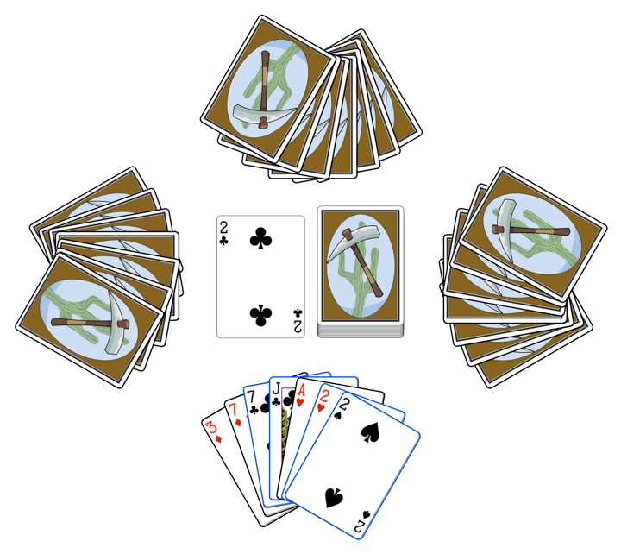
Bartok: A Game Design Exercise
Example
The player can choose to play any one of the cards highlighted with blue borders (7C, JC, 2H, 2S).
‹#›

Slide 12
Bartok: Asking the Right Questions
Analysis
Is the game of the appropriate difficulty?
Is the outcome of the game based more on strategy or chance?
Does the game have meaningful, interesting decisions?
Is the game interesting when it's not your turn?
‹#›

Slide 13
Bartok: Modifying the Rules
Each group should pick a number (1 – 3)
Based on the number, add the following rule to the game:
Rule 1: If a player plays a 2, the person to her left must draw two cards instead of playing.
Rule 2: If any player has a card that matches the number and color (red or black) of the top card, she may announce "Match card!" and play it out of turn. Play then continues with the player to the left of the one who just played the out-of-turn card. This can lead to players having their turns skipped.
Rule 3: A player must announce “Last card” when she has only one card left. If someone else calls it first, she must draw two cards (bringing her total number of cards to three).
‹#›

Slide 14
WATCH OUT FOR PLAYTESTING FLUKES
A strange shuffle or other external force can cause one playtest of the game to be very different from others
You must playtest several times to ensure that you experience an average playtest and not a fluke
However, you must also note any flukes that happen because they can also happen to players
‹#›

Slide 15
Bartok: Asking the Right Questions
How did the single rule change the game?
Have the answers to your questions changed?
Is the game of the appropriate difficulty?
Is the outcome of the game based more on strategy or chance?
Does the game have meaningful, interesting decisions?
Is the game interesting when it's not your turn?
Discuss the changes to these answers for each of the three rules
Changing a single rule can have a drastic affect on the feel of the game!
‹#›

Slide 16
Bartok: Making Your Own Rules
Now, how do you want the game to feel?
Try designing a rule to make the game feel more like this specific emotion
Change only one rule at a time
Test with the new rule and see how it feels
You don't need to complete an entire game if the rule really doesn't feel right
Work with your group to make the game your own
‹#›

Slide 17
Bartok: Discussion
What game feel was your team seeking?
What rule(s) did your team create?
How well did they work?
‹#›

Slide 18
The Definition of Game
Several very smart people have tried to define game
"A game is the voluntary attempt to overcome unnecessary obstacles" – Bernard Suits, The Grasshopper (1978)
"A game is a series of interesting decisions" – Sid Meier
"A game is a closed, formal system that engages players in a structured conflict and resolves its uncertainty in an unequal outcome" – Tracy Fullerton, Game Design Workshop (2008)
"A game is a problem-solving activity, approached with a playful attitude" – Jesse Schell, The Art of Game Design (2008)
"A game is a system of rules in which agents compete by making ambiguous, endogenously meaningful decisions" – Keith Burgun, Game Design Theory (2013)
We'll explore each one in turn
‹#›

Slide 19
Bernard Suits's Definition
"A game is the voluntary attempt to overcome unnecessary obstacles" – Bernard Suits, The Grasshopper (1978)
Attempt to create a definition that encompassed all kinds of games
Sports
Board Games
Make Believe
Accurate definition of game, but doesn't teaching designers how to make good games
Referred to make believe as "open games"
A game with the sole goal of continuance of the game
However, some open games have other goals
‹#›

Slide 20
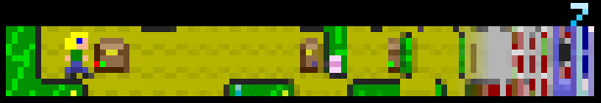
Bernard Suits's Definition
Passage by Jason Rohrer (2007)
Several possible goals:
Moving as far to the right as possible before dying (exploration)
Earning as many points as possible by finding treasure chests (achievement)
Finding a wife (socialization)
These goals are mutually exclusive
The game is about experiential understanding
Players are complicit in the decisions of the character and therefore better understand the feelings of the game character
The first of our designer's goals (see Chapter 8)
‹#›

Slide 21
Sid Meier's Definition
"A game is a series of interesting decisions" – Sid Meier
States very little about what the word game means
But states a lot about his personal beliefs about what makes a good game
What makes a decision interesting?
The player has multiple valid options from which to choose
Each option has both positive and negative potential consequences
The outcome of each option is predictable but not guaranteed
Second designer's goal: interesting decisions
‹#›

Slide 22
Tracy Fullerton's Definition
"A game is a closed, formal system that engages players in a structured conflict and resolves its uncertainty in an unequal outcome" – Tracy Fullerton, Game Design Workshop (2008)
Not only a definition of game, but also a list of elements that designers can modify
Formal elements: The elements that differentiate a game from other types of media
Dynamic systems: Methods of interaction that evolve as the game is played
Conflict structure: The ways in which players interact
Uncertainty: The interaction between randomness, determinism, and player strategy.
Unequal outcome: How does the game end? Do players win, lose, or something else?
‹#›

Slide 23
Jesse Schell's Definition
"A game is a problem-solving activity, approached with a playful attitude" – Jesse Schell, The Art of Game Design (2008)
Like Suits, it is the playful attitude of the player that defines a game
Two runners are in a race
One is running a normal race
The other is aware that there is a bomb at the finish line that she must defuse
Only one of the two is playing a game!
Third designer's goal: lusory attitude
From the Latin word for play, training, & sport: Ludus
Games should encourage the lusory attitude of players
‹#›

Slide 24
Keith Burgun's Definition
"A game is a system of rules in which agents compete by making ambiguous, endogenously meaningful decisions" – Keith Burgun, Game Design Theory (2013)
Specific terms:
Ambiguous: predictable but uncertain
Endogenously Meaningful: meaningful in the game system
Intentionally limited
Much more restricted definition than Suits or Schell
Omits play activities like make believe and competitions of skill (including sports)
Burgun attempts to restrict the definition to make it easier to understand the bounds of the field
‹#›

Slide 25
The Nebulous Nature of Definitions
Suits's book was a response to Philosophical Investigations by Ludvig Wittgenstein (1953)
Proposed that there could be no true definition of game
Rather than a definition, games shared a family resemblance
Mary Midgley also disputed this in her paper "The Game Game" (1974)
"Something can be accepted as a chair provided it is properly made for sitting on, whether it consists of a plastic balloon, a large blob of foam, or a basket slung from the ceiling. Provided you understand the need you can see whether it has the right characteristics, and aptness for that need is what chairs have in common" – Mary Midgley, "The Game Game" (1978)
‹#›

Slide 26
The Nebulous Nature of Definitions
Humans have several needs that are met by games
Structured conflict
Chess players don't want to engage in any cerebral activity, they want to experience the specific challenge of chess
The experience of being someone else
Games, make believe, and even stage plays allow people the chance to experience being someone else
Excitement
Most popular media is about excitement in one form or another
Interactive media allow players to actually take part in the excitement
Players have agency in the media that they experience
‹#›

Slide 27
The Nebulous Nature of Definitions
However, Wittgenstein did have a very important point:
Definitions change!
To each person, the word game can have different meaning
When you say you "want to play a game," do you mean:
A console game?
A board game?
A word game?
A casual game?
Words also constantly evolve
The meaning of game has changed drastically over the last 50 years
Designers are constantly expanding what game means
The IndieCade independent game festival will accept and consider anything that the designers want to call a game
‹#›

Slide 28
Why Are Definitions Important?
Definitions help you understand what people expect
Especially true if you're working in a specific genre or for a specific audience.
Understanding how your audience defines the term will help you to craft better games for them.
Definitions can lead you to understand not only the core of the defined concept but also the periphery.
Games that fit the definition perfectly, and those on the edge
The peripheries are where new genres can be created
Definitions can help you speak eloquently with others in the field.
You should also read the source material for all of these definitions to expand your understanding of game design
‹#›

Slide 29
The Core Lesson of This Book
This book teaches not only how to design games but also any interactive experience
"An interactive experience is any experience created by a designer, inscribed into rules, media, or technology and decoded by people through play" – Jeremy Gibson
Any time you create an experience for people, you should use game design methodologies
Game design takes a lot of work and experience
"Game design is 1% inspiration and 99% iteration" – Chris Swain
The iterative process of design is the key to good game design
Game design and development both take lots of practice
‹#›

Slide 30
Chapter 1 – Summary
You Are a Game Designer!
This class will teach you the techniques and technology to become a better designer
You experienced the Bartok design exercise
The definition of game is expanding
You are learning to design interactive experiences
Next chapter: Various analytical frameworks for game design
‹#›

